Slide 1
AN AUTHENTIC ENGINEERS
A Class Govt. Approved Contractor

Slide 2
AN AUTHENTIC ENGINEERS
‘A’ CLASS GOVT. APPROVED CONTRACTOR
Deals In: Fire Fighting System, Fire Extinguishers, Erection of HT/LT Electrical and Civil works

Slide 3
Company Profile
Providing solutions since 2008, AN AUTHENTIC ENGINEERS has been a very well known name for its work in the fire safety products business. We offer a wide range of equipment to our clients like Breathing Apparatus Set, Fire Hydrant, Fire Sprinkler, Fire Suppression, Fire Alarm, Fire Extinguisher Erection of HT/LT Electrical and Civil works etc.
we are also do Projects and which provides services for Erection, Installation & Commissioning of All Type of Fire Fighting Equipment, Electrical and Civil works. The company is located in Faridabad, Haryana, at a location which allows us to deliver our products to customers based in various nearby states & cities in a very short period. Moreover, we assure the customers that joining hands with us with be profitable for them.

Slide 4
About Us
We have satisfied clients from various govt. sectors and private as well, in Automobiles, Pharmaceutical, Engineering, Schools, Institutions, etc.
As an organization, we are committed to strive & achieve utmost customer satisfaction by doing quality works at the given time frame & by providing support.
We request you to provide us an opportunity to cater to your requirement, which we will do so with utmost importance. We now look forward to receive your valuable enquiry.
Thanking you & assuring you of our
best services at all times.

Slide 5
About Us
We, An Authentic Engineers, are an industry-leading trader and service provider.
Attuning ourselves with modern-day market requirements, we mainly specialize in offering a qualitative gamut of Fire Hydrant, Fire Sprinkler, Fire Extinguisher; Fire Suppression and Fire Alarm System
The company apart from the fire safety equipment's also offers varied services for fire protection keeping in view the requirements of different industries and sectors.

Slide 6
Key Facts
Key of Subject | Facts of Business
Nature of Business | Projects, Service Provider, Traders, Fire Fighting and Electricals Liseaning.
Year of Establishment | 2008
No. of Employees | 10
No. of Engineers | 3

Slide 7
Certificate
GST Certificate
“A” Class Electrical Licence

Slide 8
Certificate
ISO 9001:2015 Certificate

Slide 9
Product Range
Our range includes ABC Fire Extinguisher, Co2 Fire Extinguisher, Dry Chemical Powder Fire Extinguisher, Clean Agent Fire Extinguisher, Trolly Mounted Fire Extinguisher, Modular Automatic fire Extinguisher, Fire Alarm System, Fire Hydrants System, Fire Sprinklers, HT, LT Electricals Signages. etc.,
all of which can be custom built to order, in congruence with buyer's specifications and preferences.

Slide 10
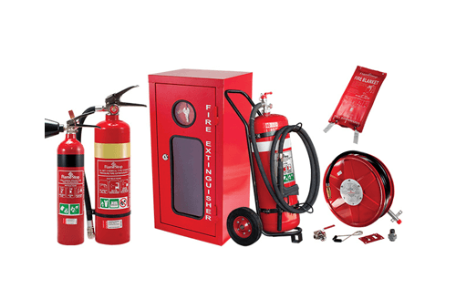
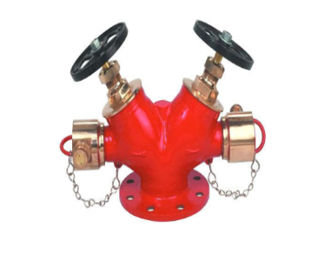
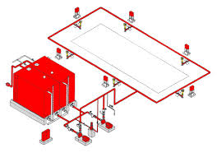
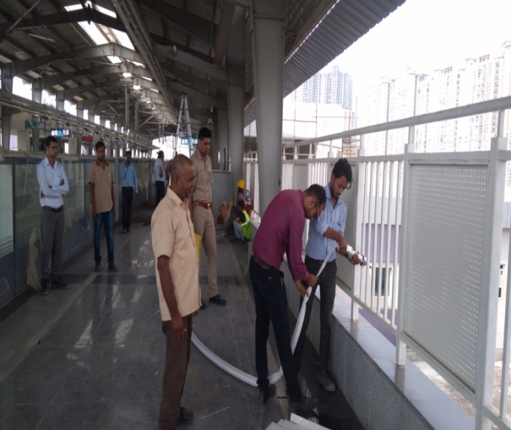
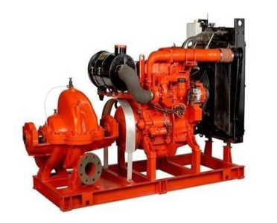
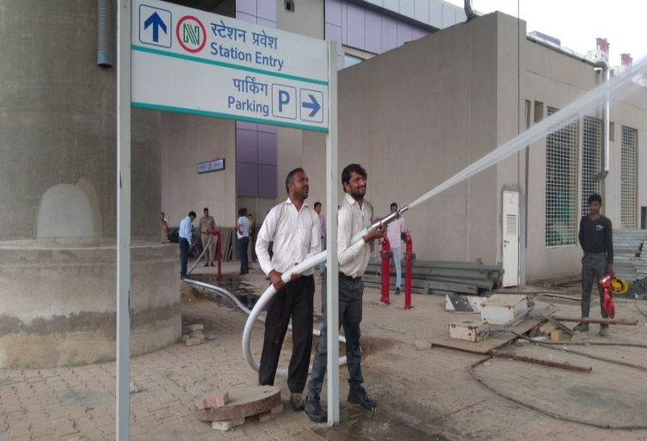
Area of Operations

Slide 11
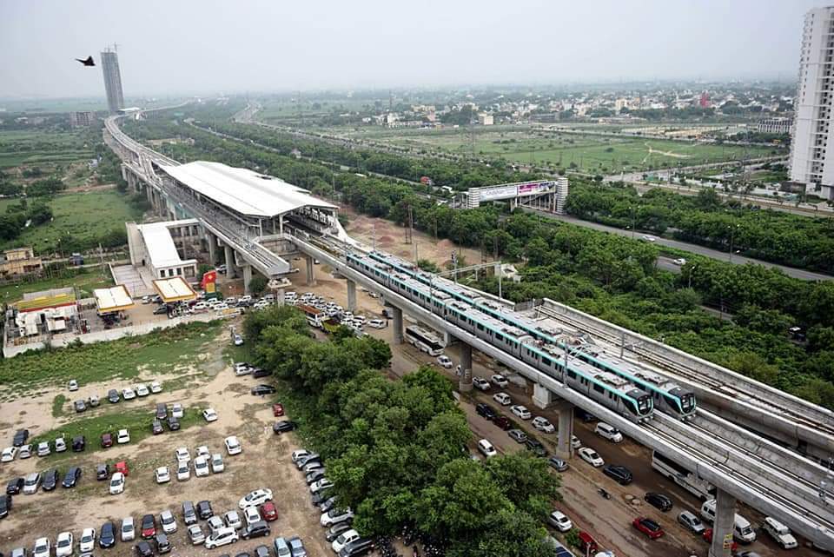
Working Project
Delhi Metro Rail Corporation

Slide 12
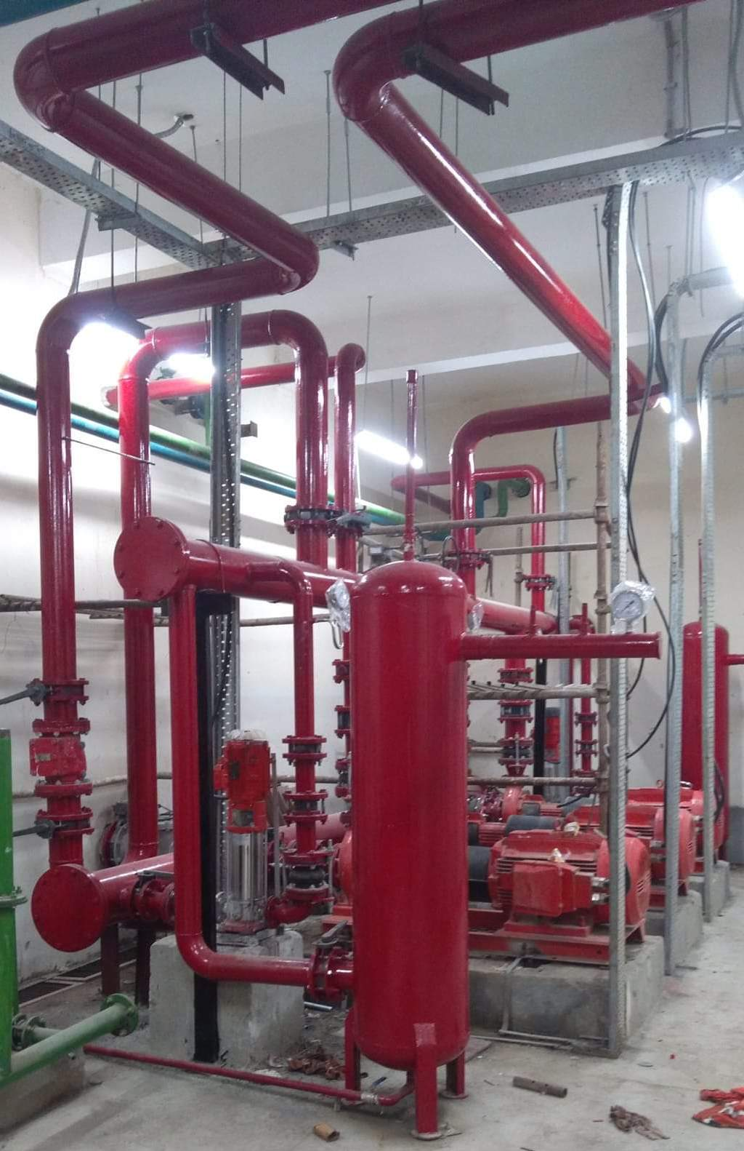
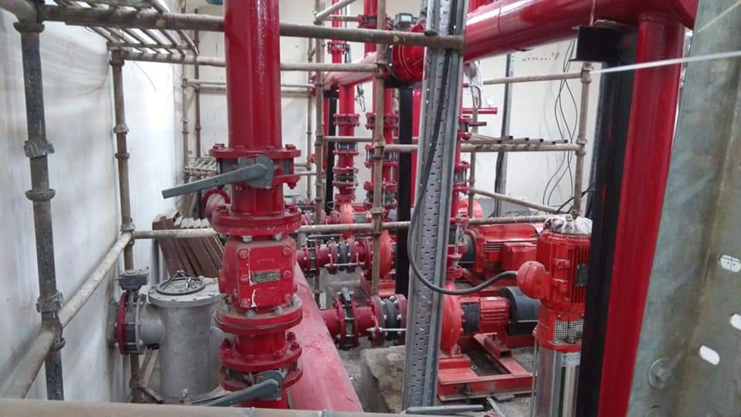
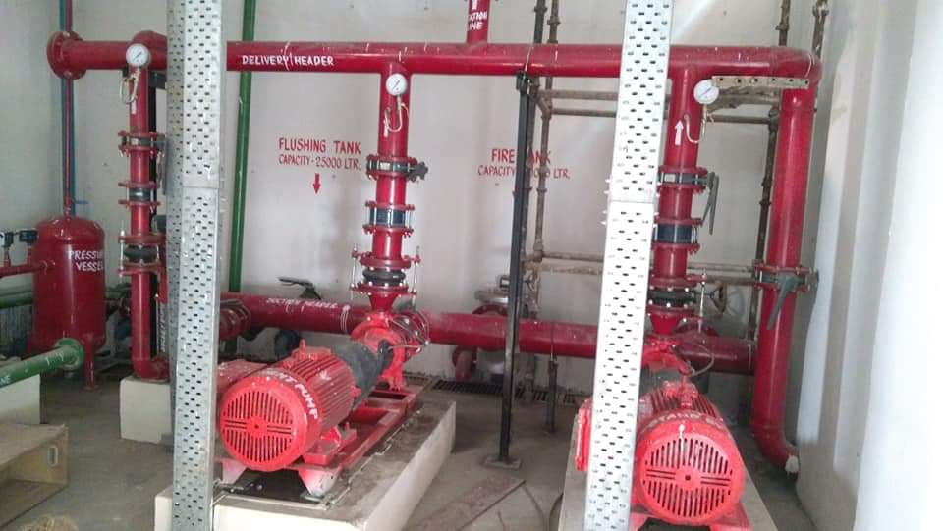
Working Project

Slide 13
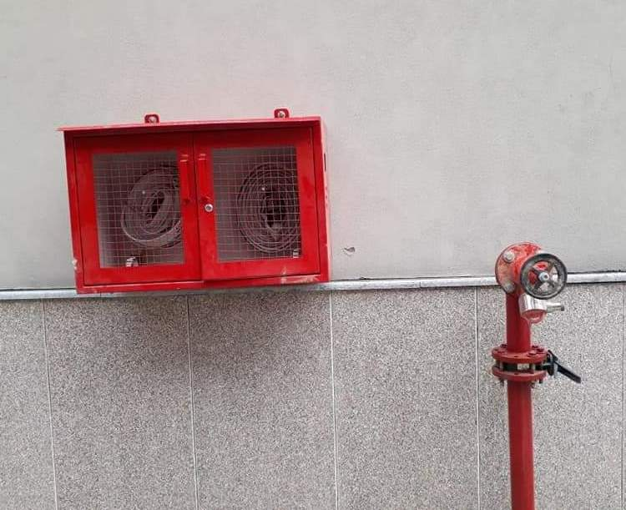
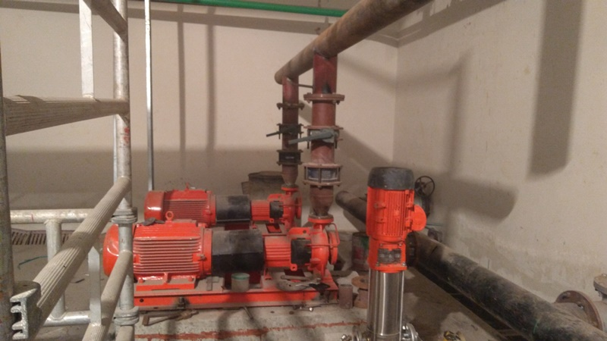
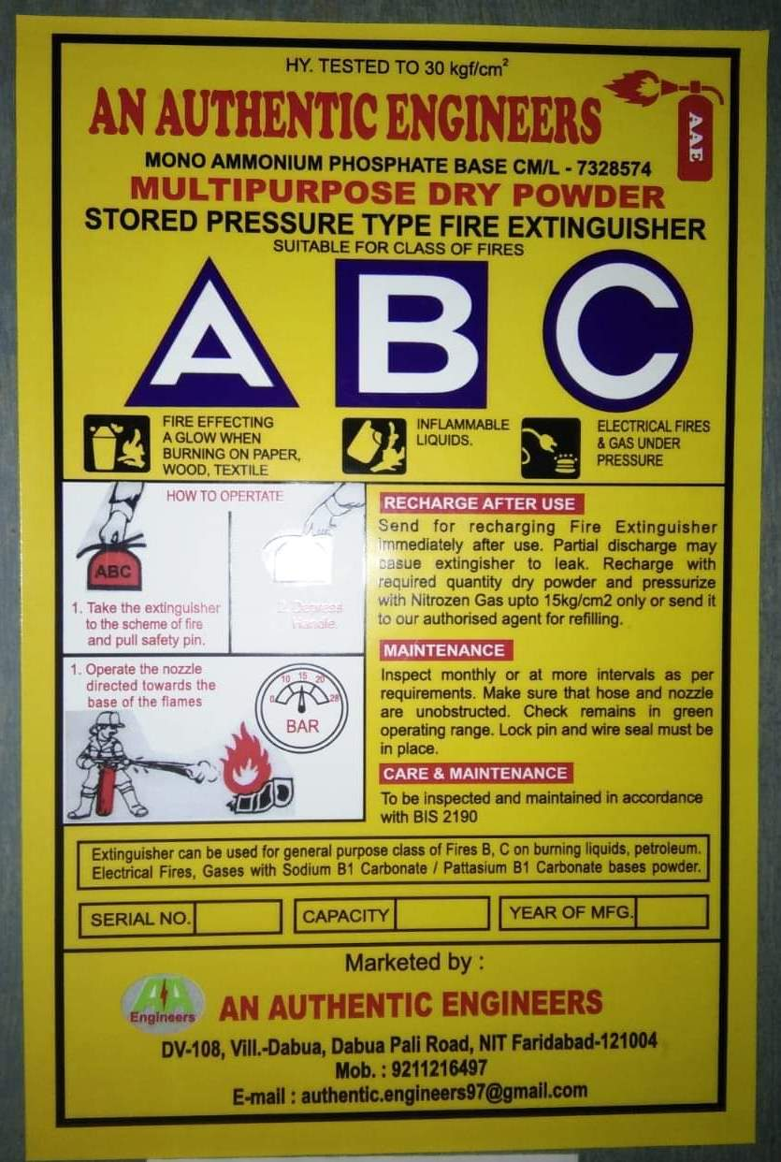
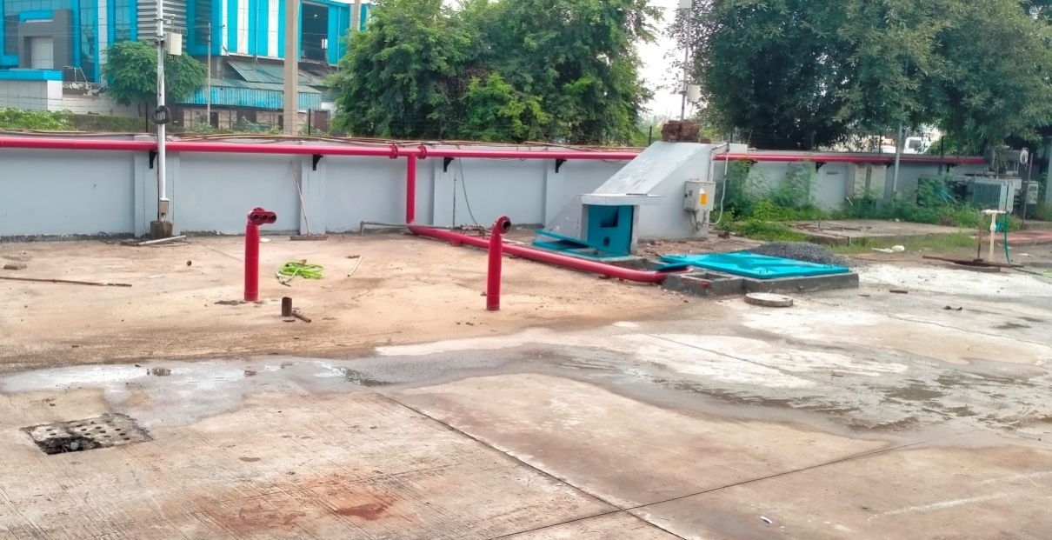
Working Project

Slide 14
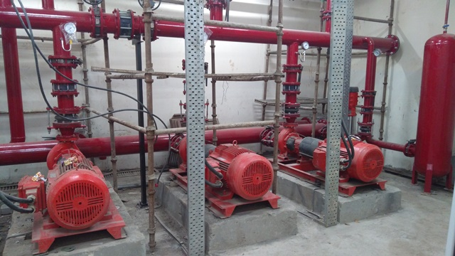
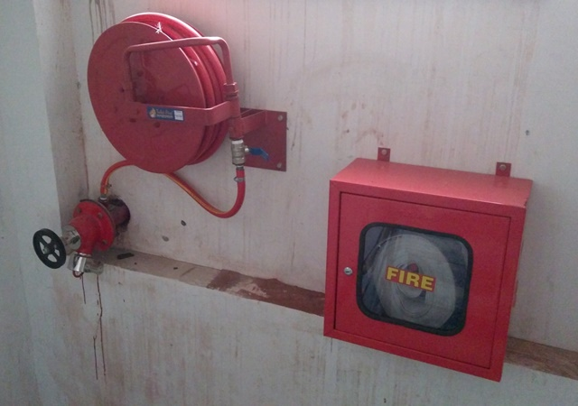
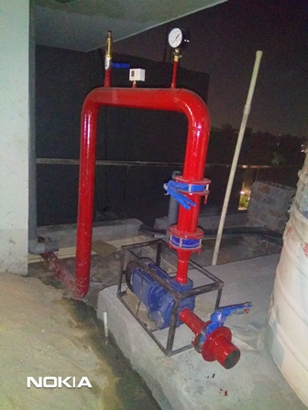
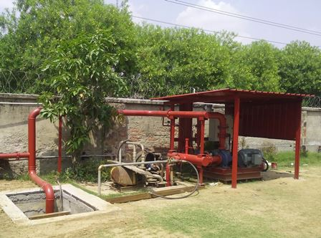
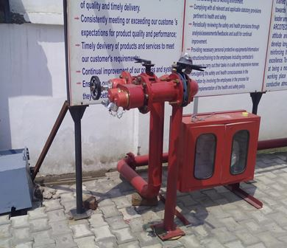
Working Project

Slide 15
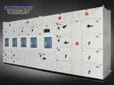
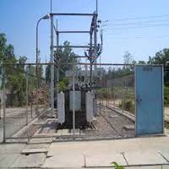
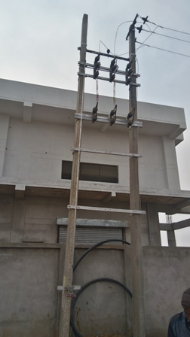
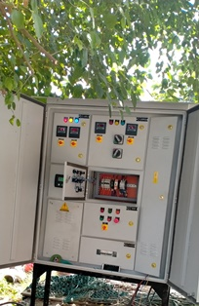
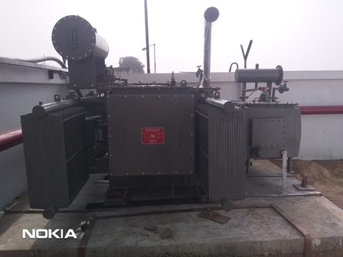
Working Project

Slide 16
Clients

Slide 17
Clients

Slide 18
Clients

Slide 19
Clients
 |  | More Client Blow

Slide 20
Clients
Utility Powertech Limited - Noida UP
Shiv Nadar University. – G.B. Nagar. UP
Godrej & Boyce Mfg Co. – Faridabad (HR)
Jindal Prefab Pvt. Ltd. – Binola, Gurgaon (HR)
Action Construction Equipment Ltd.–Palwal (HR)
Crest Geartech Pvt. Ltd.(Mahindra Group) - Faridabad (HR)
J.S.S. Steelitalia Ltd.–Hosur, Banglore. Karnataka.
iQor Global Services India Pvt Ltd.–Gurgaon, (HR)
Roop Polymers Ltd. (Site)–Sohna (HR)
Hema Engineering Ltd. (site)–Neemrana (Rajasthan)
N.I.F.M. (Govt.)–Faridabad (HR)
Govt.Press near Hardware Chowk-Faridabad (HR)
NACEN (Govt.)-Faridabad (HR)
N.P.T.I. (Govt.)–Faridabad (HR)
Nirwachen Sadan (Govt.) – New Delhi

Slide 21
Clients
Grover Sons Apparel Pvt. Ltd – IMT Manesar, Gurgaon (HR)
Sandhar Components Manesar – IMT Manesar, Gurgaon (HR)
D.E.T.C. - (West), Govt. – Faridabad (HR)
Arun Ice Factories – Faridabad (HR)
Gulati Steel – Faridabad (HR)
Orient Craft Ltd. – (New Delhi)
Indo Autotech Ltd. – Faridabad (HR)
Camma India – Faridabad (HR)
Bhullar Industries – Faridabad (HR)
Tagore Academic Public School – Faridabad (HR)
R.D.A.T. (Govt.) – Faridabad (HR)
Metro Hospitals – Gurgaon (HR)
Haryana Taxprint and O Ltd. – Faridabad (HR)
Arcotech Ltd. – Bawal, Rewari (HR)
Vinay Mangla & Others – Pathrari – Bilaspur Road, Gurgaon (HR)

Slide 22
Clients
Delite Technoplast. – NIT, Faridabad (HR)
Priyanka Impax Pvt. Ltd. – Okhla. (New Delhi)
Multishaper – Bhiwadi. Rajesthan
Vinay Mangla and Others.(AWL) – Badshapur – Sohna Road, Gurgaon (HR)
Choice Clothing Pvt. Ltd. – IMT, Manesar, Gurgaon. (HR)
A One Tubetech Pvt.Ltd. – Prithla, Palwal. (HR)
Praja Mechnical Engineering Works – Sector 25, Faridabad (HR)
TMP BULDCON PVT. LTD. - Bilaspur.Gurugram (HR)
JB TUBETECH – Bilaspur Gurugram (HR)
PROMPT Enterprises Pvt Ltd. Gadpuri, Palwal (HR)
DMV PROJECTS & ENGG. PVT.LTD. Faridabad (HR)
DESPRO TECHNOLOGIES PVT.LTD. Faridabad (HR)
Kumar Infracom Pvt Ltd Murarpur Bihar.
Eco Safetech Consultant Ballabgarh (HR)
Siddharth Gupta Punjabi Bagh, New Delhi

Slide 23
Clients
Devender Kumar Mangla Sector-47 GURUGRAM (HR)
Sia Fashions Udyog Vihar GURUGRAM (HR)
Hike Automation Sector-16A Faridabad (HR)
Amrit Graphics Pvt Ltd. Sector-58, Ballabgarh, Fbd, (HR)
Jay Ushin Ltd, Bhiwadi, Rajasthan
Athena Behavioral Health Service Pvt Ltd, Sector-47, Gurugram, (HR)
Xprt Engineered Packaging Solutions Pvt. Ltd. Faridabad (HR)
Parasmani Metals Pvt. Ltd. Dharuhera Rewari (HR)
Helping companies in setting benchmarks
of success by serving them reliable
Fire Safety Products.... (Ajay Tanwer)

Slide 24
Office
Corporate Office : | DV-108, Dabua- Pali Road, Sector-50, N.I.T. Faridabad-121001
Mail ID : | authentic.engineers97@gmail.com authentic.electricals@gmail.com
Phone No : | +91-9211216497 +91-9643520049

